Slide 1
Case 7

Slide 2
در مراجعه به یک گاوداری صنعتی یکی از گاوهای پرتولید و خوب گاوداری، حدوداً 3 هفته پس از زایش علایمی نظیر کاهش دریافت ماده غذایی و همچنین کاهش تولید را نشان می داد. علایم حیاتی حیوان طبیعی بود و تنها موردی که جلب نظر می کرد این بود که صداهای شکمبه را در قسمت جلویی تهیگاه چپ نمی توانستیم بشنویم و بجای آن در آن محدوده صداهایی با طنین زنگی چه در شنود عادی و چه در دقه می شنیدیم. تشخیص چیست؟ راه درمان و پیشگیری را بنویسید.

Slide 3
LEFT-SIDE DISPLACEMENT OF THE ABOMASUM (LDA)

Slide 4
Multifactorial
Two weeks prepartum through 2-4 weeks postpartum
High levels of concentrate: decrease in abomasal motility

Slide 5
EPIDEMIOLOGY

Slide 6
Occurrence
Large, high-producing adult dairy cows immediately after parturition
Six weeks following parturition

Slide 7
Risk factors
Dietary risk factors
High body condition scores
High-level grain feeding: increase in the concentration of volatile fatty acids
Prepartum diets containing more than 1 .65 Mcal of NE/kg of DM
High genetic merit
Low parity were Significant risk factors
Ketosis

Slide 8
Dietary crude fiber
feeding rations high in carbohydrates, inadequate levels of roughage and crude fiber levels below 17% during the last few weeks of pregnancy

Slide 9
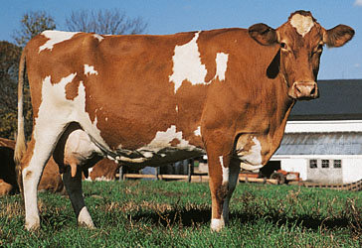
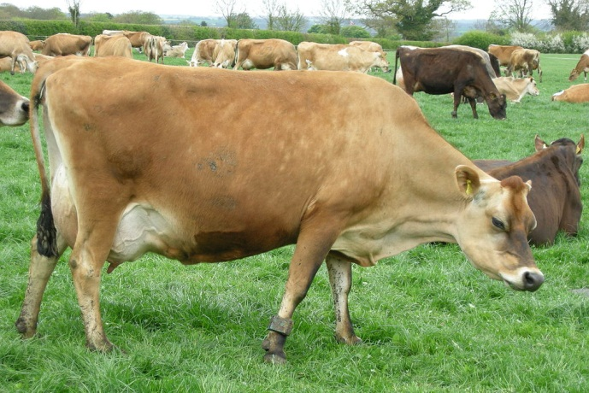
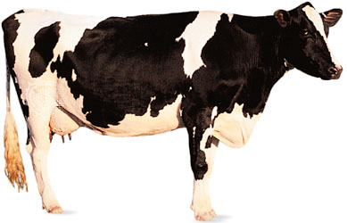
Animal risk factors
Breed and age of cow: Holstein-Friesian, Guernsey and Jersey
Greatest risk at 4-7 years of age

Slide 10
Season of the year
Abomasal volvulus and LDA were highest in January and March
Greater incidence of the disease in the spring

Slide 11
Influence of weather
Change from sunny, warm and dry days to cool, overcast and humid days

Slide 12
Late pregnancy
Following parturition, the rumen subsides, trapping the abomasum, especially if it is atonic or distended with feed
Feeding a high-roughage diet, containing at least 17% crude fiber, immediately prior to parturition is a commonly recommended and successful strategy

Slide 13
Concurrent diseases
Cows with an LDA are more likely to have had retained placenta, ketosis, stillborn calf, metritis, twins or parturient paresis than control cows

Slide 14
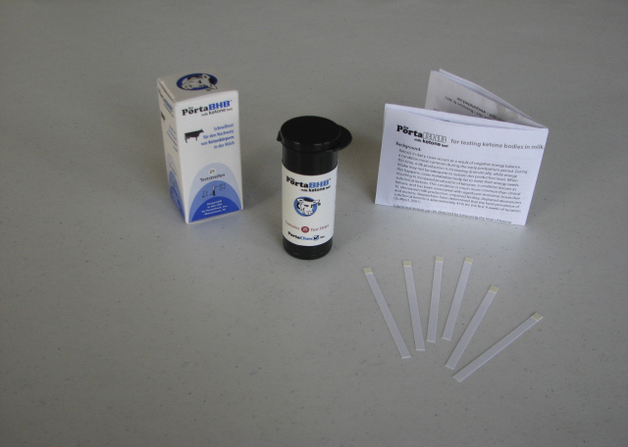
Pre-existing subclinical ketosis
AST, serum and milk BHB and milk Fat/Protein
Two milk ketone tests as predictors of LDA in dairy cows within 2 weeks of parturition

Slide 15
Hypocalcemia
Blood calcium levels affect abomasal motility
Controversial

Slide 16
Metabolic predictors of LDA
Prepartum: Non-esterified fatty acids (NEFA)
Postpartum beta-hydroxybutyrate (BHB)
The strategic use of metabolic tests to monitor transition dairy cows should focus on NEFA in the last week prepartum and BHB in the first week postpartum

Slide 17
Economic importance
Lost milk production during the illness
Cost of the surgery
Cows with LDA are more likely to be removed from the herd
Low milk production is a common reason for removal of cows with LDA

Slide 18
PATHOGENESIS

Slide 19
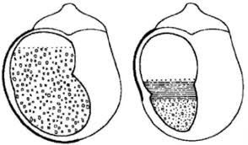
Reduce the rumen volume by one-third at the end of gestation
This also forces the abomasum forward and slightly to the left side of the abdomen
After calving
A decline in plasma concentration of calcium around the time of parturition
Ruminal raft depth

Slide 22
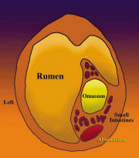
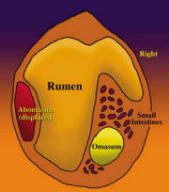
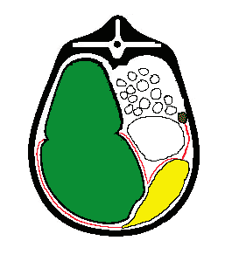
Atonic gas-filled abomasum becomes displaced under the rumen
Floaters

Slide 23
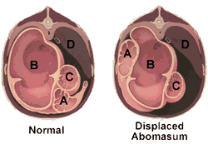
In cows with an LDA and high concentrations of blood glucose and insulin, the myoelectrical activity of the abomasum was reduced
Compression by the rumen of the impounded part of the abomasum

Slide 24
The obstruction of the displaced segment is incomplete
A mild metabolic alkalosis with hypochloremia and hypokalemia are common

Slide 25
CLINICAL FINDINGS

Slide 26
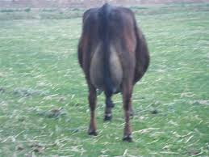
General appearance and ketosis
Inappetence, sometimes almost complete anorexia, a marked drop in milk production and varying degrees of ketosis
Diagnosis an LDA that was treated for ketosis, improved for a few days and then relapsed
Slab-sided
T/H/R

Slide 27
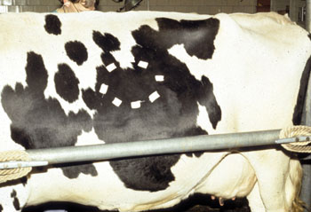
Status of reticulorumen an spontaneous abomasal sounds
Ruminal movements are commonly present but decreased in frequency and intensity
The rumen sounds may not be audible over an area anterior to the fossa

Slide 28
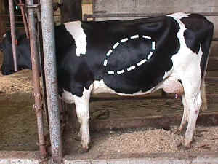
Auscultation of an area

Slide 29
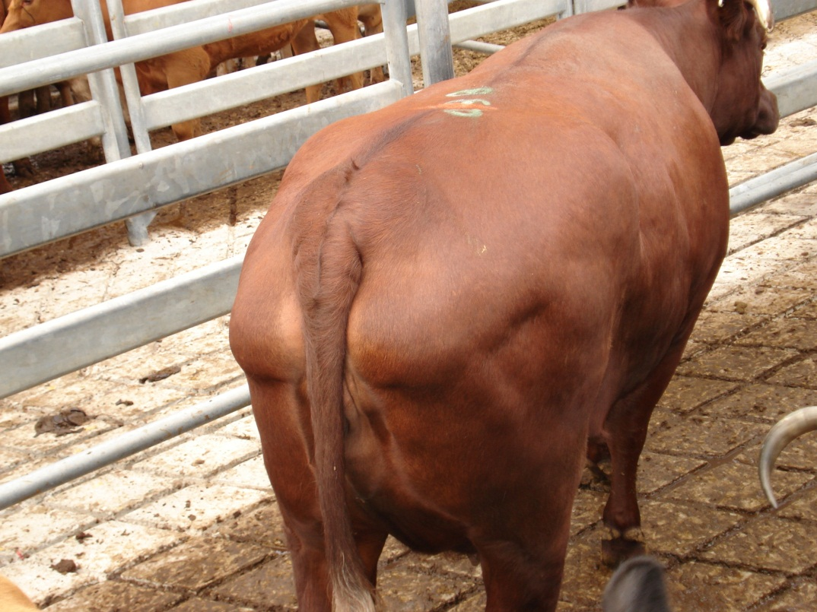
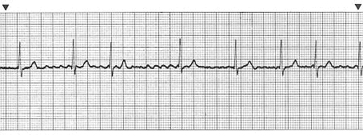
Rectal examination
Secondary ketosis and fatty liver
Atrial fibrillation
Course of LDA

Slide 30
CLINICAL PATHOLOGY

Slide 31
Hemogram
No marked changes in the hemogram
A moderate to severe ketonuria
Mild hemoconcentration
A mild metabolic alkalosis with slight hypochloremia and hypokalemia

Slide 32
Serum biochemistry
Ketosis
AST and BHB
In cows with fatty liver, plasmal lipoprotein concentrations are decreased
Decreased level of apo-100 and apoA-1
Dairy cows with LDA : low plasma and liver α-tocopherol
Plasma vitamin E values may decrease in cows with increased liver triglyceride content
Mild hypocalcemia

Slide 33
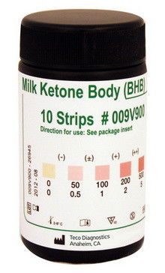
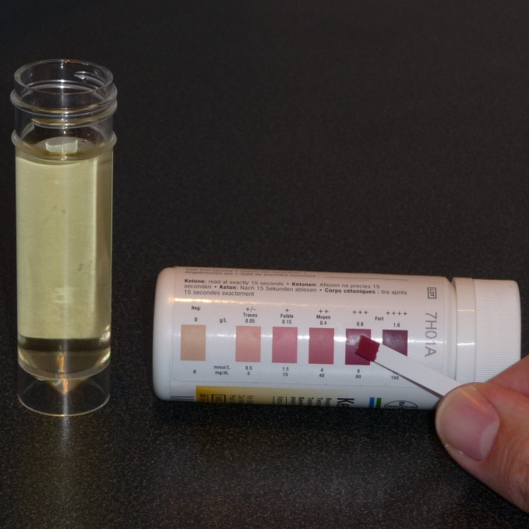
Cowside tests of milk and urinary ketones
Ketolac test strip were highly sensitive for the detection of subclinical ketosis when used in milk
Urine ketones: Ketostix

Slide 34
Abomasocentesis
10th or 11th intercostal space in the middle third of the abdominal wall

Slide 35
DIFFERENTIAL DIAGNOSIS
Simple indigestion
Primary ketosis
TRP
Vagus indigestion
Fat cow syndrome

Slide 36
TREATMENT
Open surgical techniques
Closed suture techniques
Treatment of ketosis: Parenteral dextrose and oral propylene glycol
Rumen transfaunation following surgery

Slide 37
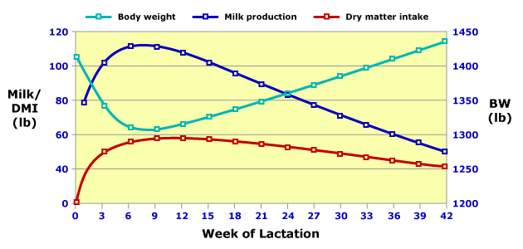
CONTROL
Transition period occurring 2-3 weeks before and after calving

Slide 38
Retained fetal membranes, metritis and either clinical or subclinical ketosis and hypocalcemia are probable risk factors for LDA
Excessive amounts of concentrate, or too rapid an increase in concentrate feeding during the peripartum period

Slide 39
Prepartum nutrition and management
Avoid a negative energy balance prepartum
Feed some concentrates prior to calving
Maximize dry matter intake in the immediate postpartum period
Ensure palatable feed and water available to periparturient cows
Energy density of prepartum diets should not exceed 1.65 Mcal of NE/kg of DM

Slide 40
Crude fiber intake
Adequate intake of a highfiber diet to dairy cows during the 'far-off‘ and 'close-up' periods
At least 17% fiber for control and minimize the subacute ruminal acidosis

Slide 41
Monensin in controlled-release capsule prepartum
Prevention of subclinical ketosis
335 mg of monensin per day for 95 days
3 weeks before calving

