Slide 1
Case report 1 and 2

Slide 3
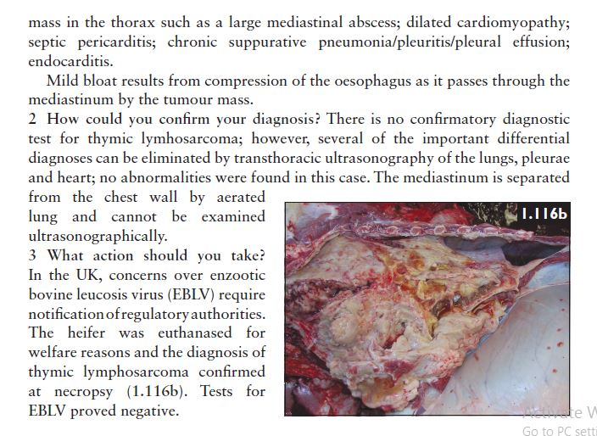

Slide 5
